Slide 1

Technologies to detect, analyze and report online hate speech
Demetris Paschalides
Research assistant, University of Cyprus
dpasch01@cs.ucy.ac.cy
https://www.cs.ucy.ac.cy/~dpasch01/
Workshop: “From Online Hate Speech to cyber-terrorism”, 8 February 2017

Slide 2
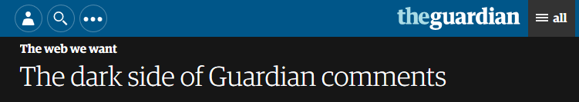
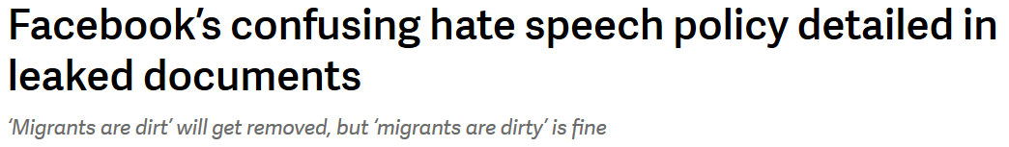
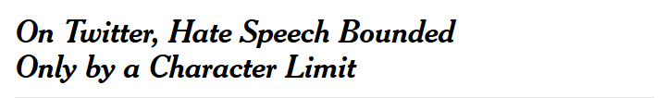
Challenge
Major Social Networks and Web sites cannot properly address the problem of online hate speech.
Workshop: “From Online Hate Speech to cyber-terrorism”, 8 February 2017

Slide 3

Our Objectives
Monitor the spread of online hate-related speech.
Analyse its content and the categories to which it might belong (Ethnicity, Nationality, Religion, Gender, Sexual, Class, Disability).
Store and visualize actionable information for policy makers, to promote policies against online hate speech, and citizens, to raise their awareness.
Do that without holding any user’s sensitive data, by processing data on the fly, following a procedure approved by the Cyprus Data Protection Commissioner.
Article 7(1)(2) of the Personal Data Protection, N. 138(I)/2001
Workshop: “From Online Hate Speech to cyber-terrorism”, 8 February 2017

Slide 4





MANDOLA Tools
A bundle of tools to tackle online hate-speech and clear our objectives.
Monitoring
Dashboard
Mobile
Application
Workshop: “From Online Hate Speech to cyber-terrorism”, 8 February 2017

Slide 5
Monitoring Dashboard
Consists of the following modules:
  Data Streams Collection ( Twitter and Web pages)
  Hate-speech Data Analysis ( Multi-lingual Classifier )
  Data Storage ( Hate-speech statistical database )
  MANDOLA Application Interface – API
  Monitoring Dashboard Web Application
Data
Streams
Collection
Hate-speech Data Analysis
Data Storage
A
P
I
Monitoring Dashboard
Workshop: “From Online Hate Speech to cyber-terrorism”, 8 February 2017

Slide 6



Data Stream Collections
.distinct( "dept" )
Consist of two sub-modules :
  Twitter data stream is collected via Twitter Stream API using a framework to efficiently retrieve large collection of tweets per day (developed by University of Cyprus).
  Web data stream is collected via meta-search engine that crawls possible hate-related web pages (developed by University Autonomous of Madrid, Spain).
Each collected stream is fed to Apache Kafka, a queuing system for supporting streaming data processing.
“Distributed Large-Scale Data Collection in Online Social Networks” H. Efstathiades et al. IEEE CIC 2016
Workshop: “From Online Hate Speech to cyber-terrorism”, 8 February 2017

Slide 7
Twitter Data Stream
Master
Token Pool
Data Collection
Data Collection
Collector Instance
1
Collector Instance
N
Collector Instance
1
Collector Instance
N
Apache Kafka
“Distributed Large-Scale Data Collection in Online Social Networks” H. Efstathiades et al. IEEE CIC 2016
“Online Social Network Evolution: Revisiting the Twitter Graph” H. Efstathiades et al. Best student paper award, IEEE Big Data 2016
Workshop: “From Online Hate Speech to cyber-terrorism”, 8 February 2017

Slide 8

Web Data Stream
URL 1
Crawling Module
Extract Links
Save Links
Get Links
Links
Scrap Web
Analyze & Extract Data
URL N
Save New Links
Extract Links
Save Links
Prof. Alvaro Ortigosa
Marcos Hernando
Workshop: “From Online Hate Speech to cyber-terrorism”, 8 February 2017

Slide 9
Hate-speech Data Analysis
Input data comes from Apache Kafka are preprocessed to enter the Classifier.
Multi-lingual Hate-speech Corpus, continuously enriched, supports and retrains the Classifier.
The Classifier receives the input and outputs the Hate-speech analysis to be stored.
Data
(from Apache Kafka)
Hate-speech Classifier
Multi-lingual Corpus
Preprocessing
Output
Workshop: “From Online Hate Speech to cyber-terrorism”, 8 February 2017

Slide 10
Preprocessing
Removes non-linguistic features as:
  URLs e.g. http://www.google.com
  Hashtags e.g. #MANDOLA
  Emails e.g. dpasch01@cs.ucy.ac.cy
  User Mentions e.g. @mandola_project
Expands any abbreviation found.
  e.g. “thanx”= “thank you”
Applies more linguistic processing.
This helps us to store less unique words in the Multi-lingual corpus and improve the Classifiers performance.
“Detecting Offensive Tweets via Topical Feature Discovery over a Large Scale Twitter Corpus” Guang Xiang, Bin Fan, Ling Wang, Jason I. Hong, Carolyn P. Rose, 2016
Workshop: “From Online Hate Speech to cyber-terrorism”, 8 February 2017

Slide 11


Hate-speech Classifier
Multi-lingual classifier trained with machine learning techniques.
Trained with Mllib, Apache Spark's scalable machine learning library.
Training data and Testing data comes from the Multi-lingual corpus.
The output consists of statistical data only, and does not hold vulnerable information.
Workshop: “From Online Hate Speech to cyber-terrorism”, 8 February 2017

Slide 12
Multi-lingual Corpus 1/2
Multi-lingual sets of hate-related speech in the different hate categories.
It is produced from the Filtering Mechanism and Social Scientists manually annotated text.
The system will continuously enrich this corpus so to be up to date.
Enrichment from System
Multi-lingual Corpus
Sample Dataset
Hate Filtering Mechanism
Social Scientists
Workshop: “From Online Hate Speech to cyber-terrorism”, 8 February 2017

Slide 13
Multi-lingual Corpus 2/2
Subjectivity Classifier: Hate-speech tends to be opinionated, thus subjective sentences are more likely to contain hate-speech than objective.
Polarity Classifier: Hate-speech tends to have negative meaning, thus sentences with negative polarity are more likely to contain hate-speech (Hatebase and AFINN).
Text Pre-processing
Subjectivity Classifier
Polarity Classifier
“Hatebase,” Mobiocracy, Sentinel Project for Genocide Prevention, 2008
“A new ANEW: Evaluation of a word list for sentiment analysis in microblogs,”, F. Å. Nielsen 2011.
Workshop: “From Online Hate Speech to cyber-terrorism”, 8 February 2017

Slide 14
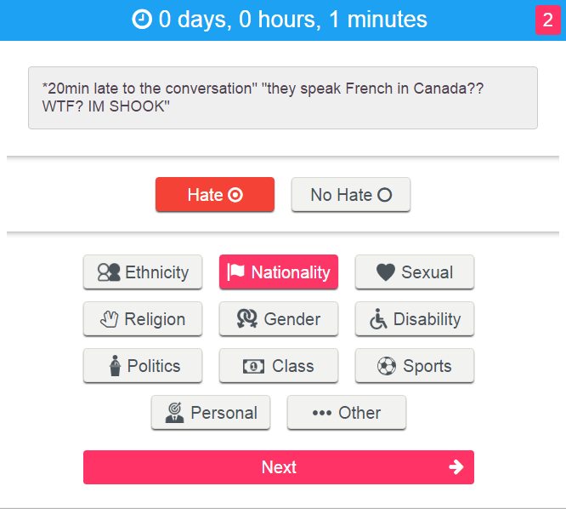

Social Scientists
Their task is to annotate if provided data contain hate-speech and the category to which they belong.
To do so the MANDOLA annotation system was developed.
Workshop: “From Online Hate Speech to cyber-terrorism”, 8 February 2017

Slide 15

Monitoring Dashboard
Web application
Built with HTML5, CSS3 and JavaScript.
Compatible with any web browser.
Responsive (Twitter’s Bootstrap) and compatible with any mobile device.
Can be found at: https://goo.gl/CnXttH
Password: m@nd0la_20!6
Workshop: “From Online Hate Speech to cyber-terrorism”, 8 February 2017

Slide 16
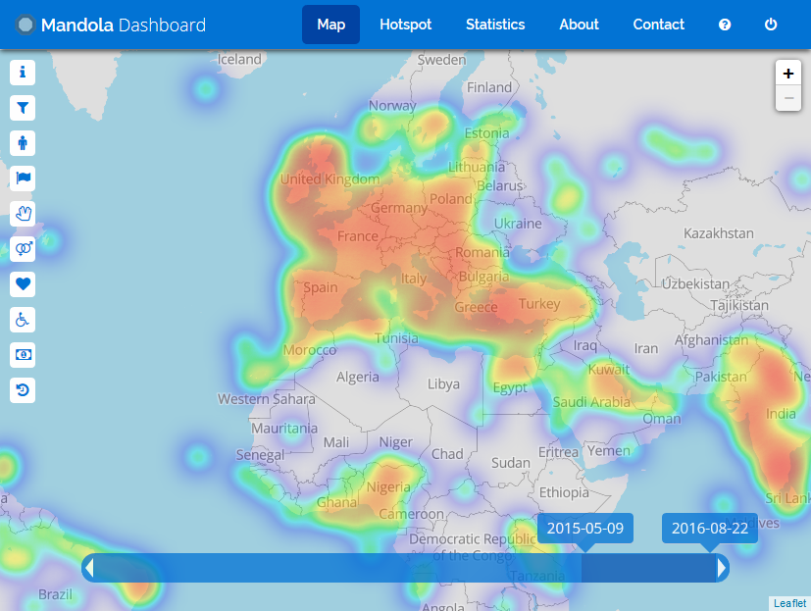

Dashboard - Hatemap
URL: https://goo.gl/CnXttH
Password: m@nd0la_20!6
These Visualizations are based on mock data and have nothing to do with real hate-speech analysis.
Workshop: “From Online Hate Speech to cyber-terrorism”, 8 February 2017

Slide 17
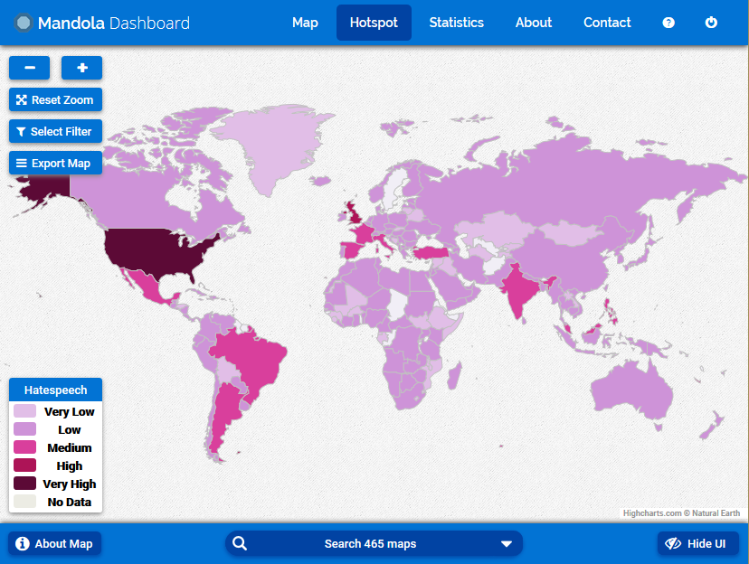
Dashboard – Hotspot [1/3]
URL: https://goo.gl/CnXttH
Password: m@nd0la_20!6
These Visualizations are based on mock data and have nothing to do with real hate-speech analysis.
Workshop: “From Online Hate Speech to cyber-terrorism”, 8 February 2017

Slide 18
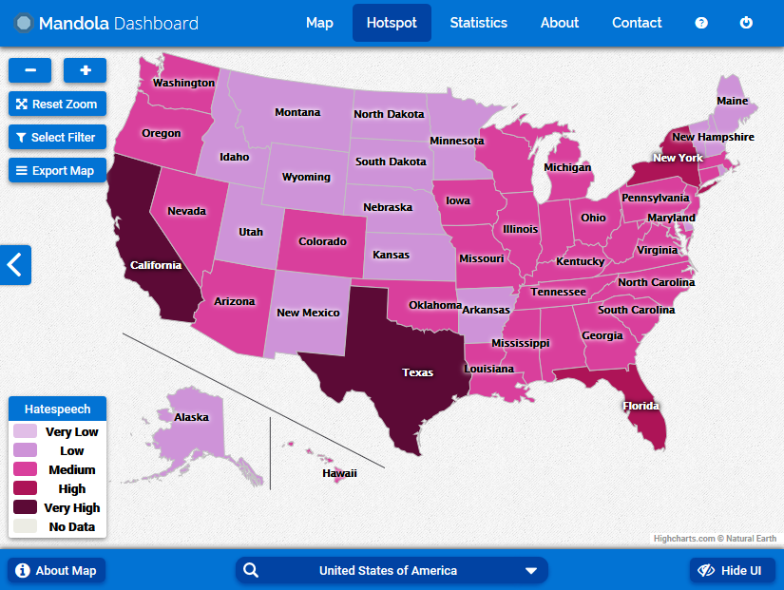
Dashboard – Hotspot [2/3]
URL: https://goo.gl/CnXttH
Password: m@nd0la_20!6
These Visualizations are based on mock data and have nothing to do with real hate-speech analysis.
Workshop: “From Online Hate Speech to cyber-terrorism”, 8 February 2017

Slide 19
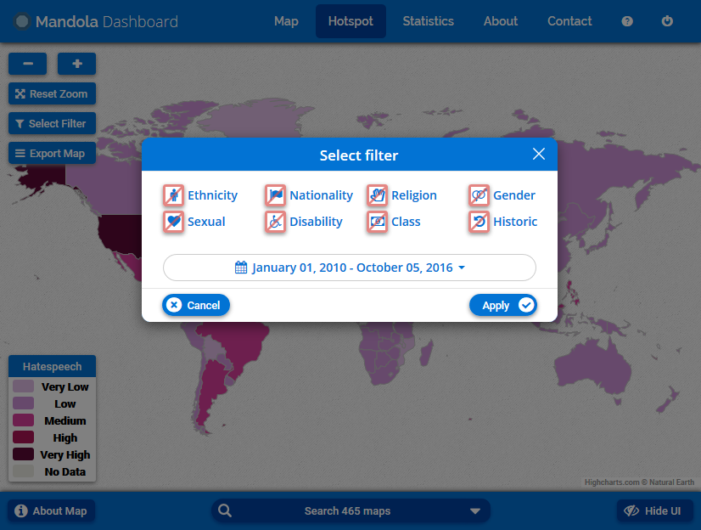
Dashboard – Hotspot [3/3]
URL: https://goo.gl/CnXttH
Password: m@nd0la_20!6
These Visualizations are based on mock data and have nothing to do with real hate-speech analysis.
Workshop: “From Online Hate Speech to cyber-terrorism”, 8 February 2017

Slide 20
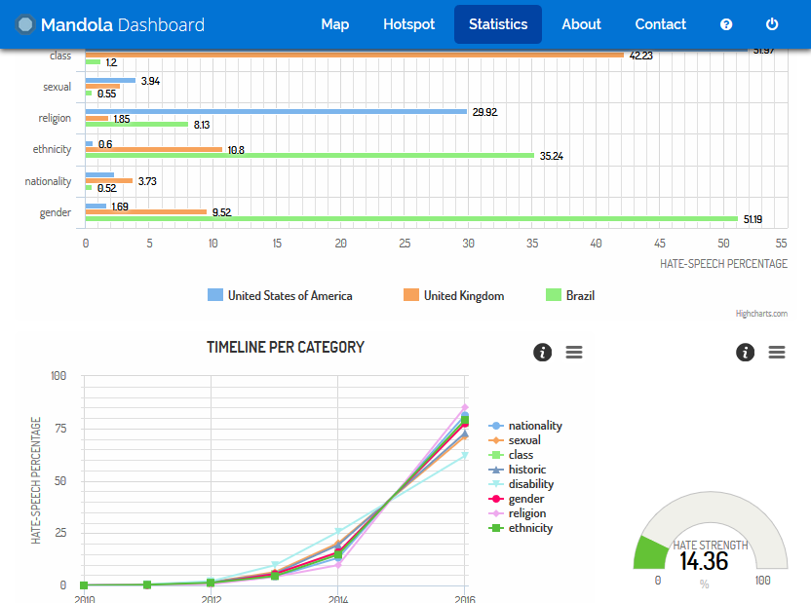
Dashboard - Statistics
URL: https://goo.gl/CnXttH
Password: m@nd0la_20!6
These Visualizations are based on mock data and have nothing to do with real hate-speech analysis.
Workshop: “From Online Hate Speech to cyber-terrorism”, 8 February 2017

Slide 21
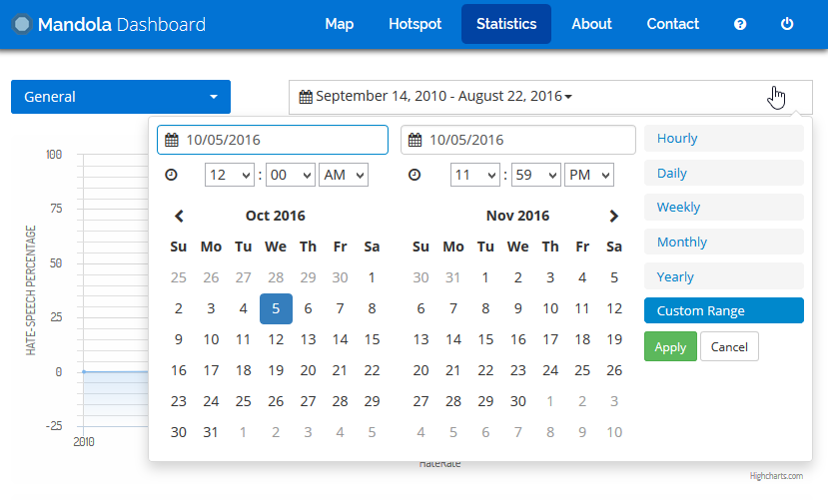
Dashboard – Statistics
Date-range
URL: https://goo.gl/CnXttH
Password: m@nd0la_20!6
These Visualizations are based on mock data and have nothing to do with real hate-speech analysis.
Workshop: “From Online Hate Speech to cyber-terrorism”, 8 February 2017

Slide 22
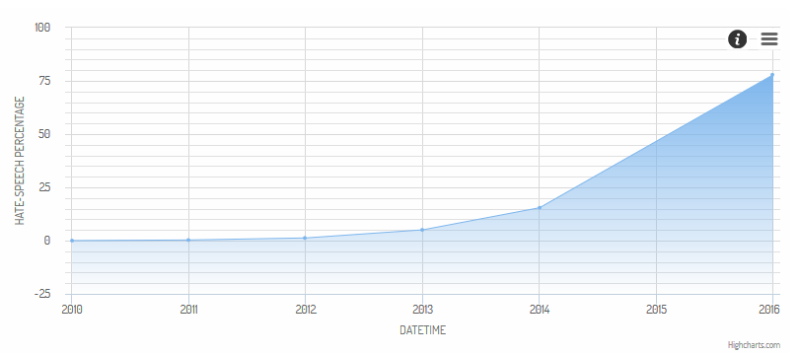
Dashboard – Statistics
Timeline
URL: https://goo.gl/CnXttH
Password: m@nd0la_20!6
These Visualizations are based on mock data and have nothing to do with real hate-speech analysis.
Workshop: “From Online Hate Speech to cyber-terrorism”, 8 February 2017

Slide 23
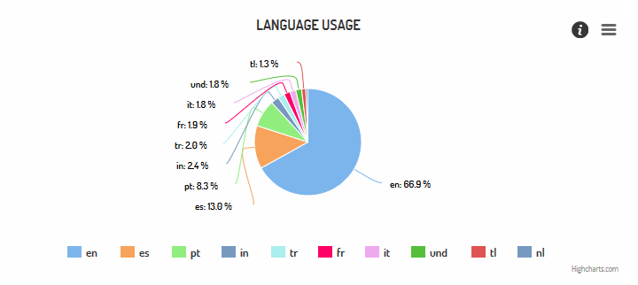
Dashboard – Statistics
Language Usage
URL: https://goo.gl/CnXttH
Password: m@nd0la_20!6
These Visualizations are based on mock data and have nothing to do with real hate-speech analysis.
Workshop: “From Online Hate Speech to cyber-terrorism”, 8 February 2017

Slide 24
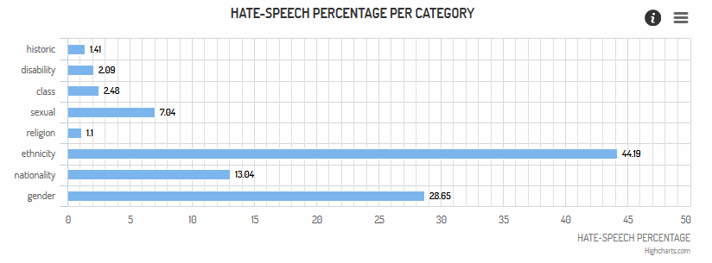
Dashboard – Statistics
Hate Percentage per Category
URL: https://goo.gl/CnXttH
Password: m@nd0la_20!6
These Visualizations are based on mock data and have nothing to do with real hate-speech analysis.
Workshop: “From Online Hate Speech to cyber-terrorism”, 8 February 2017

Slide 25
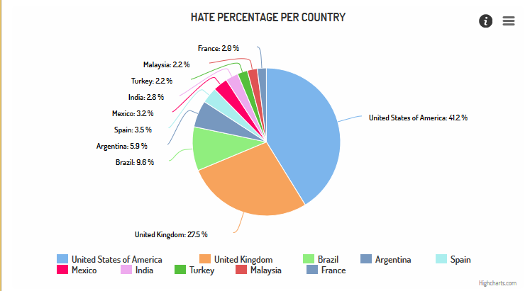
Dashboard – Statistics
Hate Percentage per Country
URL: https://goo.gl/CnXttH
Password: m@nd0la_20!6
These Visualizations are based on mock data and have nothing to do with real hate-speech analysis.
Workshop: “From Online Hate Speech to cyber-terrorism”, 8 February 2017

Slide 26
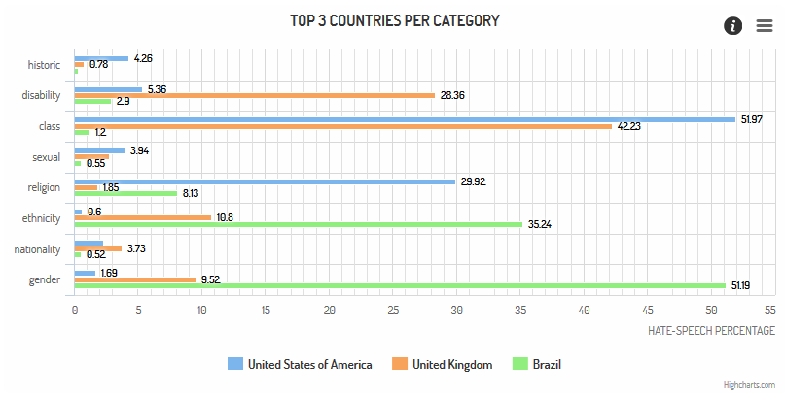
Dashboard – Statistics
Top Three Countries
URL: https://goo.gl/CnXttH
Password: m@nd0la_20!6
These Visualizations are based on mock data and have nothing to do with real hate-speech analysis.
Workshop: “From Online Hate Speech to cyber-terrorism”, 8 February 2017

Slide 27
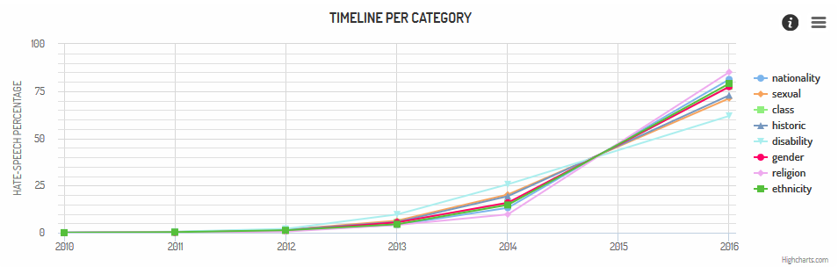
Dashboard – Statistics
Categories Timeline
URL: https://goo.gl/CnXttH
Password: m@nd0la_20!6
These Visualizations are based on mock data and have nothing to do with real hate-speech analysis.
Workshop: “From Online Hate Speech to cyber-terrorism”, 8 February 2017

Slide 28
Ongoing Development
Event labeling in hate-speech timeline.
  Users will be able to append events in the timeline in order to relate them with the chart.
  This way correlations between the hate-speech analysis and certain events can be found.
Animation of hate-speech analysis during a period of time.
  Help the users see the changes of hate-speech via animating the results for a certain duration.
Workshop: “From Online Hate Speech to cyber-terrorism”, 8 February 2017

Slide 29

Mobile Application
Its main objectives are:
  Support anonymous reporting.
  Raise online hate-speech awareness by viewing statistical analysis and FAQs.
  Compatible for Android and IOS devices.
Development technologies:
  Cordova which enables you to develop an application with web technologies.
  HTML, CSS and JavaScript.
Workshop: “From Online Hate Speech to cyber-terrorism”, 8 February 2017

Slide 30
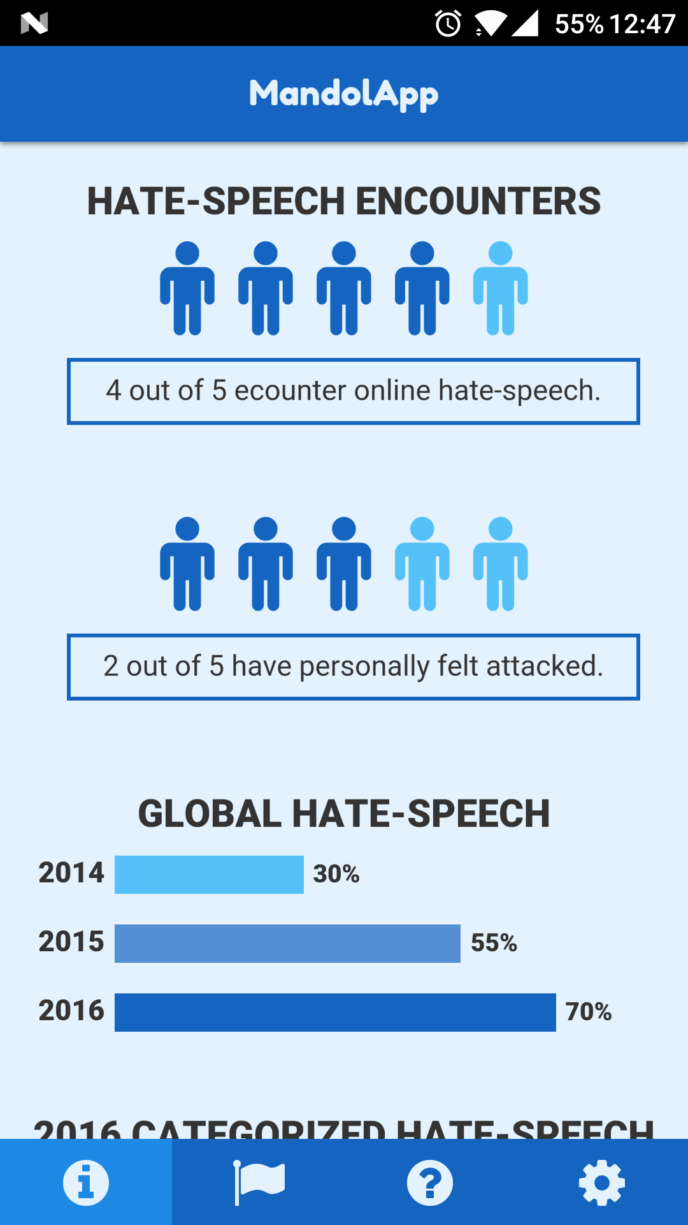
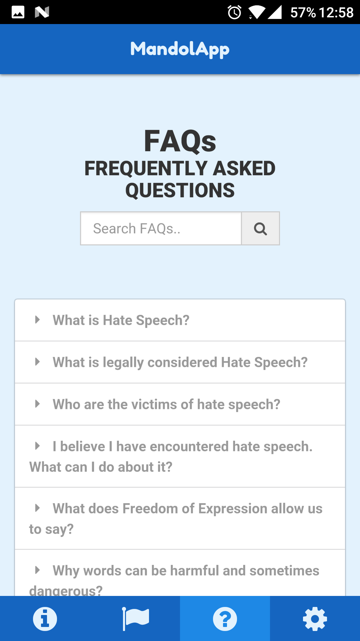
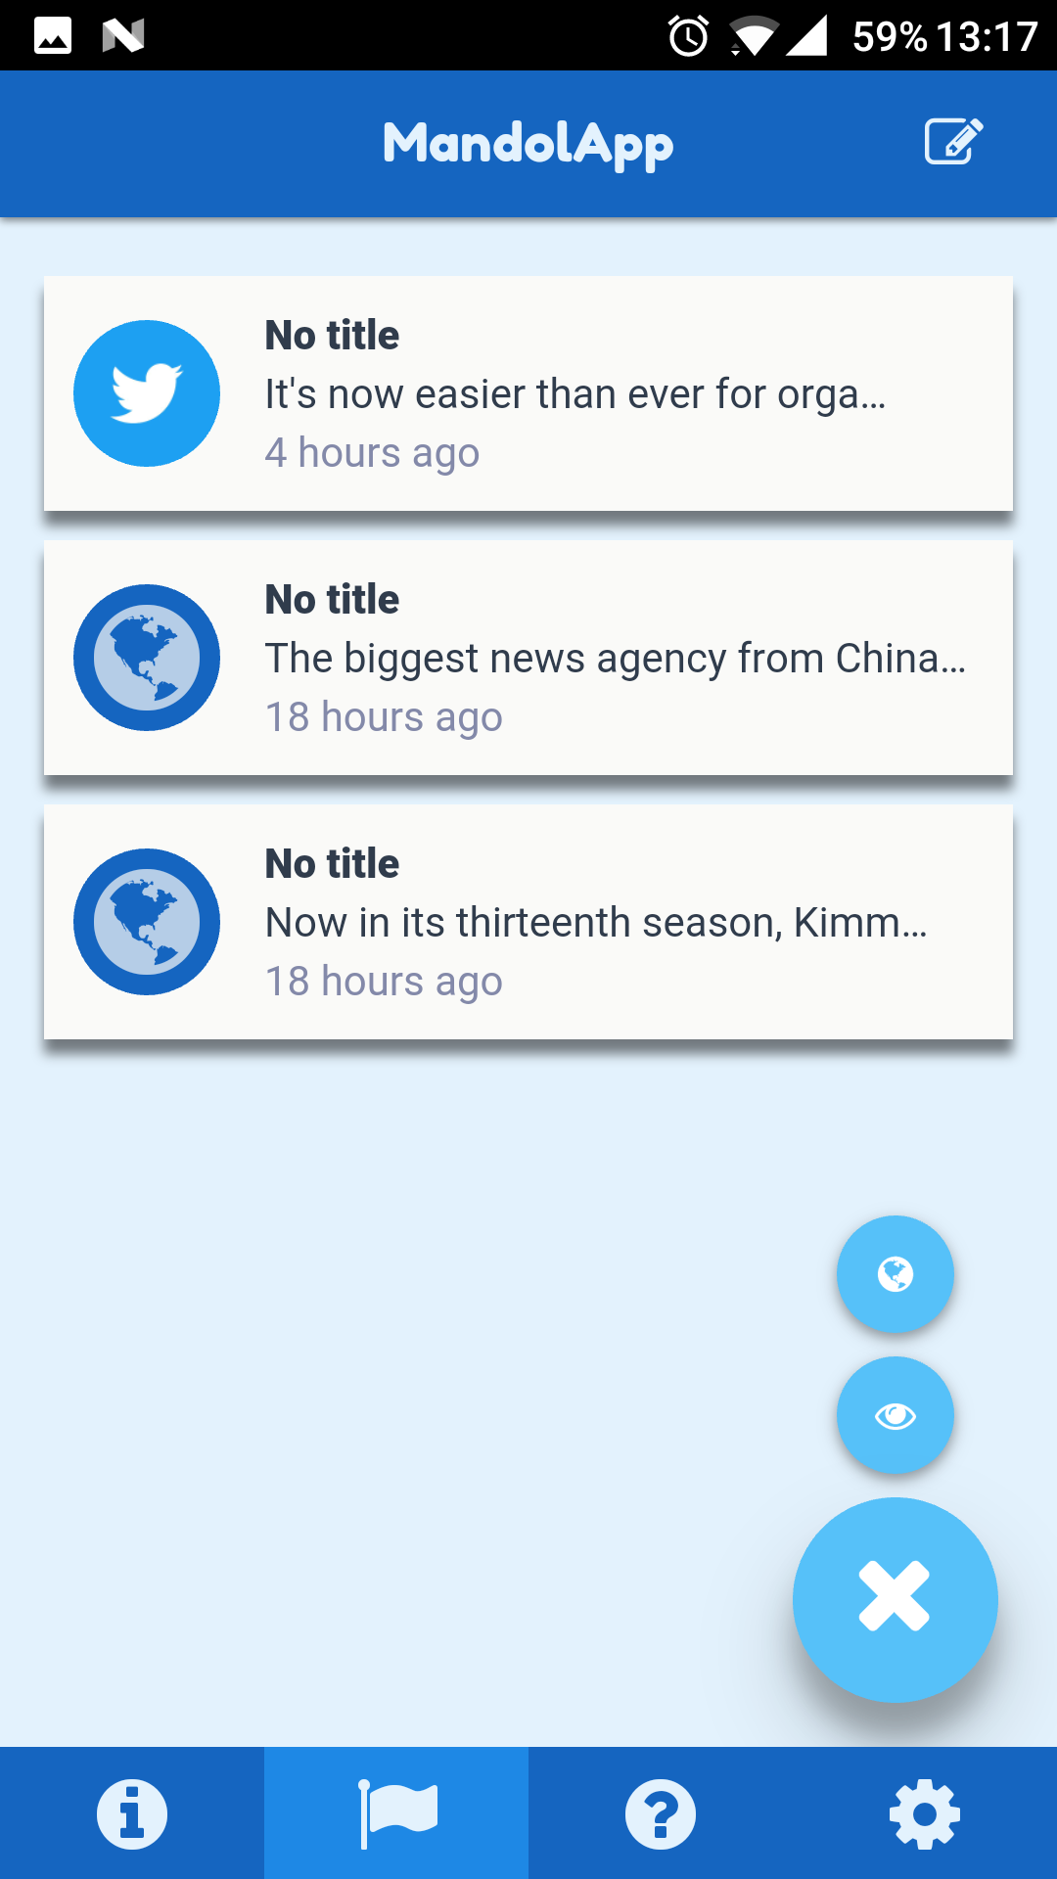
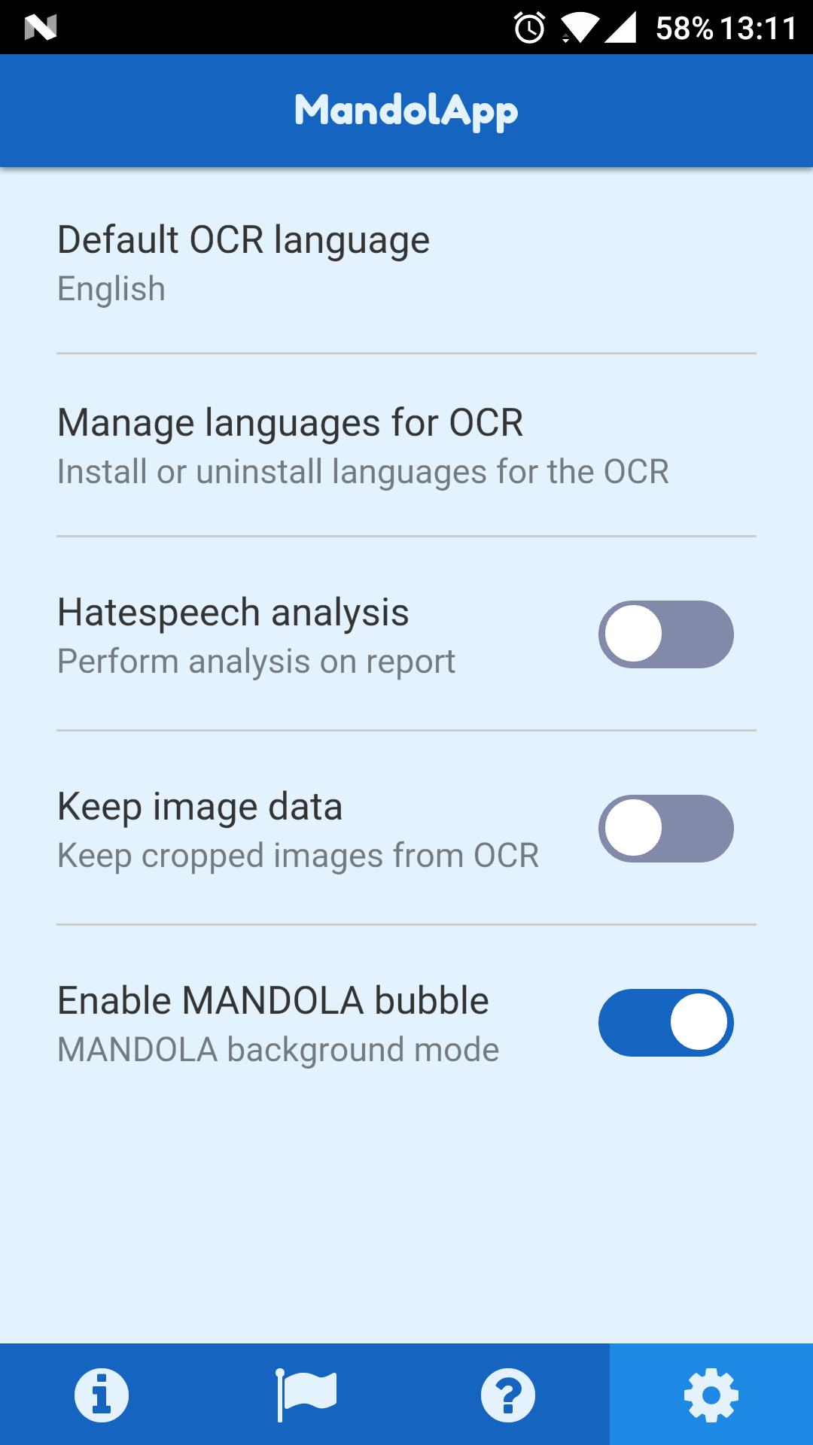
Mobile Application Interfaces
Awareness View
FAQs View
Report View
Settings View
Workshop: “From Online Hate Speech to cyber-terrorism”, 8 February 2017

Slide 31

Acknowledgments
This work has been produced with the financial support of the Rights, Equality and Citizenship (REC) Programme of the European Union under Grant Agreement JUST/2014/RRAC/AG/HATE/6652
Harrys Efstathiades | Tatiani Synodinou | Alvaro Ortigosa | Marcos Hernando | George Pallis | Marios Dikaiakos
Workshop: “From Online Hate Speech to cyber-terrorism”, 8 February 2017

Slide 32

Workshop: “From Online Hate Speech to cyber-terrorism”, 8 February 2017

