Slide 1
MANDOLA: Monitoring and Detecting on-line Hate Speech
Evangelos Markatos
FORTH and U of Crete

Slide 2
Roadmap
Who we are
What do we do?
Why?
How?

Slide 3
Roadmap
Who we are
What do we do?
Why?
How?

Slide 4
Our Background
Partners of the project are active in
Cyber security
Cybercrime research and education
Illegal Internet Content Reporting

Slide 5
Our Background – Cyber security
SysSec: European Network of Excellence in Cybersecurity
Founding coordinator
Editor of Red Book in Cybersecurity
NIS (Network and Information Security) Platform
Strategic Research and Innovation Agenda
ECSO: European Cybersecurity Organization for the cPPP
Founding members (Spain and Greece)
(alt.) member of the Partnership Board
Strategic R&I Agenda co-editor

Slide 6
Our Background – Cybercrime Research and Education
National Centers of Excellence in cybercrime
Founding coordinators in
Spain, Greece, and Bulgaria
Safeline: Greek Hotline to report illegal Internet content
Founder and first coordinator
SENTER: European Network of National Centers of Excellence in cybercrime
Founding member and WP leader

Slide 7
Roadmap
Who we are
What do we do?
Why?
How?

Slide 8
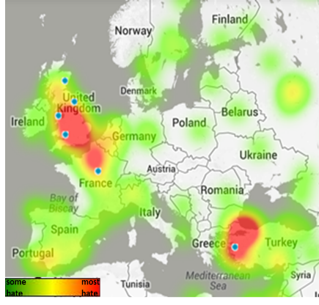
What do we want to do in MANDOLA?
Monitor
the spread and penetration of
on-line hate speech in EU
Call for proposals (from 2014) reads:
“Monitoring and reporting on hate crime and on-line hate speech (HATE)”
Mock up data

Slide 9
Roadmap
Who we are
What do we do?
Why?
How?

Slide 10
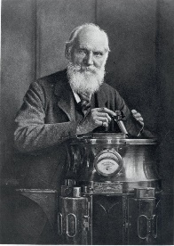
Why?
If you can not measure it you can not improve it
Lord Kelvin
Measurements are at the core
of solid conclusions
and sound actions

Slide 11
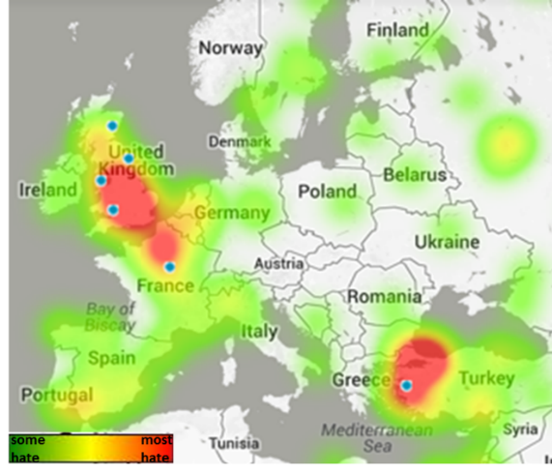
How to measure it?
Twitter-based approach
Collect tweets
Apply a hate-detection filter
From Hatebase:
A database of hate words
https://www.hatebase.org/
Apply sentiment analysis
To find hate speech
http://www.nltk.org/
Use humans to
correct and train the system
i.e. remove false positives
Mock up data

Slide 12
Roadmap
Who we are
What do we do?
Why?
How?

Slide 13
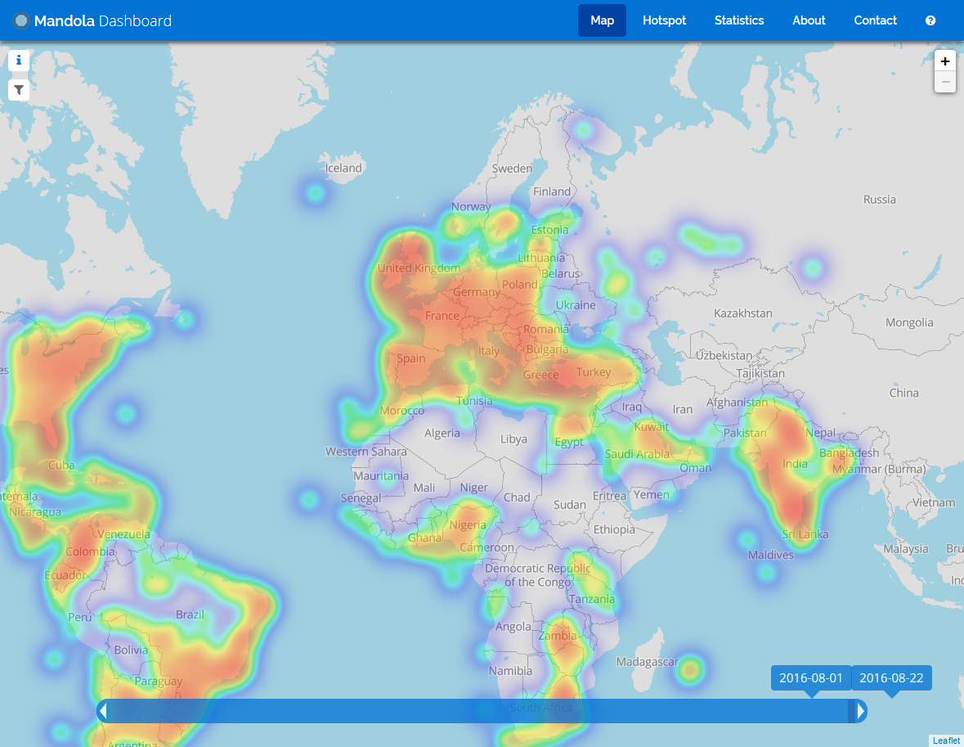
DashBoard is up and running

Slide 14
Per-country views

Slide 15
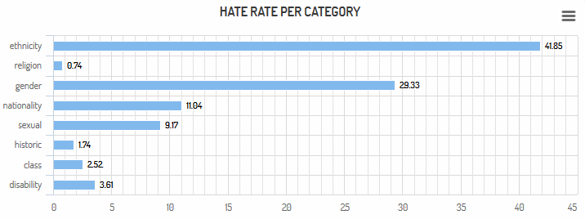
Various views I
Category
Mock up data

Slide 16
Various views II
Timeline

Slide 17
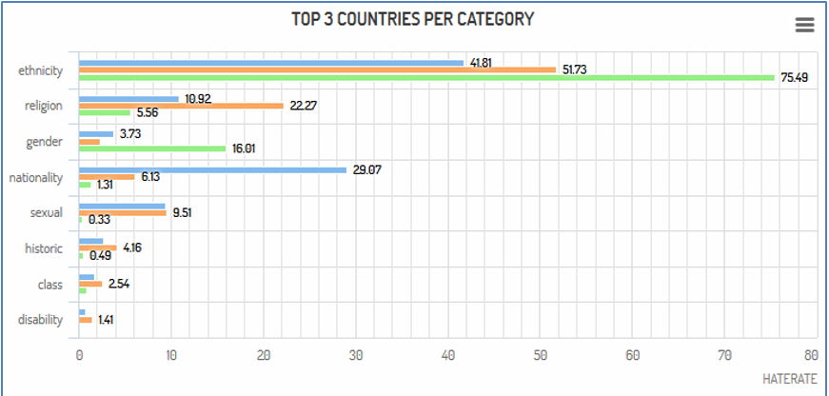
Various views III
Per country Category

Slide 18
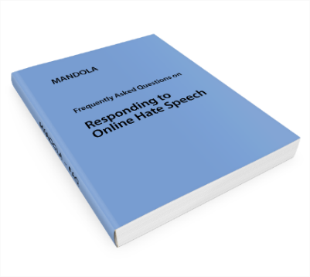
Other activities? Frequently Asked Questions
FAQ Book
What to do?
I believe I have encountered hate speech. What can I do about it?
Why words can be harmful and sometimes dangerous?
I believe I have been a target of hate speech? What are my rights as a victim?

Slide 19
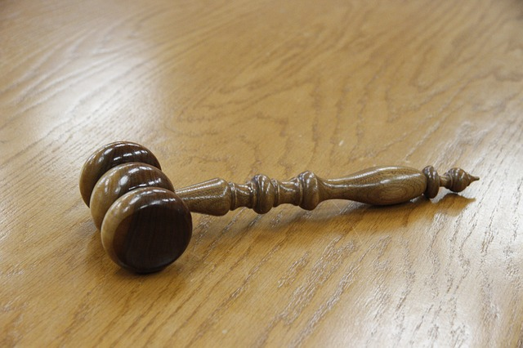
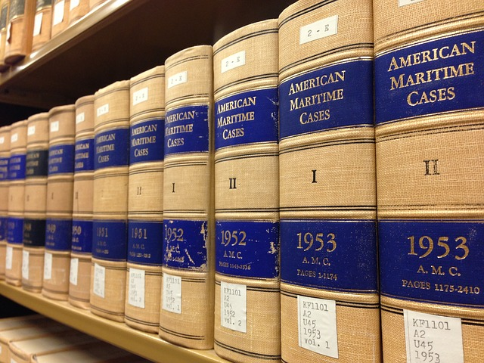
Other activities? Legal
Definition
What is hate speech
Legal Framework
In Member States

Slide 20
Who?
FORTH (coordinator), GR
U of Cyprus, CY
AIS, IE
ICITA, BG
Bulgarian Center of Excellence in cybercrime
UAM, SP
Spanish Centers of Excellence in cybercrime
UMO, FR
Member of the French CoE in cybercrime
INTHEMIS, FR

Slide 21
Thank you
Evangelos Markatos
FORTH and U of Crete

